Slide 1

Customer Segmentation
SRM INSTITUTE OF SCIENCE AND TECHNOLOGY
SCHOOL OF COMPUTING
DEPARTMENT OF COMPUTING TECHNOLOGIES
21CSC305P- MINOR PROJECT
Batch ID: 16
Reg. No: RA2211003011093
Name: M. Durga Prasad
Reg. No:RA221100301104
Name: K. Yaswanth
Reg. No: RA2211003011107
Name: S. Tejaswi
Reg No.: RA2211003011123
Name: V. Yaswanth
Guide name: Dr.Poornima S
Designation: Associate Professor Department: C.Tech

Slide 2
Customer Segmentation
Introduction
In today's competitive market, businesses must understand their customers at a granular level to effectively meet their needs and enhance customer loyalty. Customer segmentation is a powerful data-driven approach that divides a company's customer base into distinct groups based on similar characteristics, such as purchasing behavior, demographic information, and preferences. By identifying these segments, companies can develop personalized marketing strategies, optimize product offerings, and improve customer engagement. The objective of this project is to leverage data analysis to create actionable customer segments, enabling more targeted and efficient business decisions.

Slide 3
Problem Statement
The traditional approach to customer segmentation is often manual, subjective, and inefficient, leading to missed opportunities for personalized marketing and customer engagement.
As businesses grow, understanding large and diverse customer bases becomes increasingly difficult, resulting in generalized marketing strategies that fail to address specific customer needs and preferences.
Without a clear understanding of different customer segments, companies risk losing valuable customers by not providing targeted offers or services that resonate with their unique behaviors and characteristics.
The challenge is to develop an automated system that can efficiently analyze customer data, identify distinct segments, and provide actionable insights, allowing businesses to tailor their marketing efforts, improve customer satisfaction, and drive growth.

Slide 4
Objectives
Automate Customer Segmentation: Develop a machine learning system to automatically analyze and segment customers based on behavioral, demographic, and transactional data, reducing manual effort in identifying key segments.
Enhance Personalization: Improve the precision of marketing strategies by identifying distinct customer groups, enabling the delivery of personalized offers, products, and communications that resonate with each segment.
Optimize Resource Allocation: Help businesses allocate marketing and sales resources more efficiently by focusing efforts on the most valuable customer segments, maximizing ROI.
Scalability: Ensure the system can process and analyze large volumes of customer data, making it adaptable to businesses of varying sizes and industries.
Real-time Insights: Provide real-time or near-real-time customer segmentation, allowing businesses to quickly adapt to changing customer behaviors and market trends.

Slide 5
Customer Segmentation
Literature review
S.No | Title | Author | Inference | Link
1. | “Customer Segmentation Using Hierarchical Clustering “ (2024) | Areeba Afzal, Laiba Khan, Muhammad Zunnurain Hussain, Muzzamil Mustafa, Aqsa Khalid, Nawaz khan | Our dataset encompasses a diverse range of mall customers, spanning demographics and behavioral attributes. Hierarchical clustering systematically groups customers into clusters, revealing distinct segments within the mall’s customer base. A comprehensive analysis of these clusters unveils profound insights into customer tendencies, preferences, and purchasing habitsBy leveraging hierarchical clustering for mall customer segmentation, businesses can enhance customer satisfaction, drive sales, and foster lasting customer relationships. | https://ieeexplore.ieee.org/document/10543349
2. | “Customer Segmentation using K-means Clustering” (2018) | Tushar Kansal, Suraj Bahuguna,Vishal Singh., Tanupriya Choudhury | The process of segmenting the customers with similar behaviours into the same segment and with different patterns into different segments is called customer segmentation. In this paper, 3 different clustering algorithms (k-Means, Agglomerative, and Meanshift) are been implemented to segment the customers and finally compare the results of clusters obtained from the algorithms. | https://ieeexplore.ieee.org/document/8769171
3. | “An efficiency analysis on the TPA clustering methods for intelligent customer segmentation” (2017) | Ananthi Sheshasaayee, Santhosh S, L. Logeshwari | Now a day's commercial marketing growth is improved by customer segmentation model. Literatures use the data mining technology to review the customer segmentation and sound effectives. Stages of CRM have been used in most of the cases. Based on RFM, demographic and LTV data the paper is prepared using the data mining tools for the new customer segmentation | https://ieeexplore.ieee.org/document/7975573
4. | “Market segmentation using ML” (2023) | Juhi Singh, Kritika Jaiswal, Minal Singh, Muskan Sama, Swasti Singhal | Market segmentation is an approach whose aim is to identify and outline the market segments on which an organization can target for its marketing plans. Market Segmentation is used not only for selling a commodity and various services but also plays a crucial role in meeting the customer’s needs because without customers there is no business. So satisfying a customer’s need is really important and hence the need for market segmentation. The general objective of this research service is to analyze various factors which influence the student’s admission process in various private institutions | https://ieeexplore.ieee.org/document/10150639

Slide 6
Customer Segmentation
Proposed System / Methodology
Approach
The objective is to perform customer segmentation using unsupervised machine learning techniques. The two primary clustering methods—K-Means Clustering and Hierarchical Clustering—will be applied to identify distinct customer groups based on their behaviors and characteristics. The approach will include the following steps:
Data Collection and Understanding:
Load the customer segmentation dataset.
Understand the data structure, data types, and identify key features relevant to segmentation.
Data Preprocessing:
Handle missing values by removing or imputing them.
Standardize the data using techniques like StandardScaler to ensure that all features contribute equally to the clustering process.
Select only the numeric columns that are meaningful for clustering (e.g., customer age, income, spending score, etc.).
Clustering Analysis:
K-Means Clustering:
Apply the Elbow Method to determine the optimal number of clusters.
Fit the K-Means model with the chosen number of clusters.
Assign cluster labels to each customer and analyze the results.
Hierarchical Clustering:
Generate a dendrogram to visualize hierarchical relationships and determine the optimal number of clusters.
Fit the Hierarchical Clustering model based on the determined number of clusters.
Assign cluster labels to each customer and analyze the results.

Slide 7
Customer Segmentation
Proposed System / Methodology
Model Evaluation and Comparison:
Evaluate the clustering performance using the Silhouette Score to measure the quality of clusters.
Compare the results of K-Means and Hierarchical Clustering based on visualization, interpretability, and silhouette score.
Select the best-performing model to understand distinct customer segments.
Insights and Interpretation:
Interpret the clusters formed by the chosen model to derive actionable insights for marketing strategies, customer targeting, and personalized promotions.

Slide 8
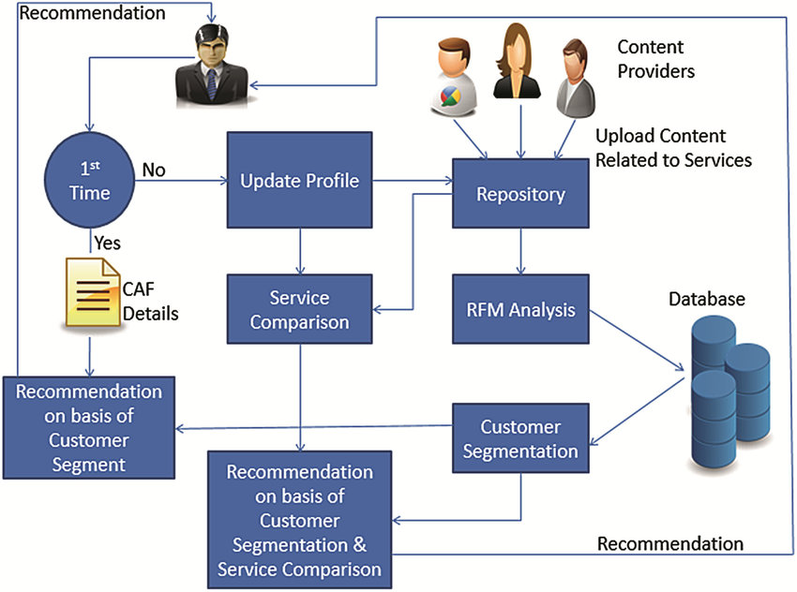
Architectural Diagram

Slide 9
Technologies/Tool Used:
Python Programming Language:
Python will be used as the primary programming language due to its wide range of libraries and tools for data analysis and machine learning.
Jupyter Lab/Notebook:
Jupyter Lab or Notebook will be used as the development environment for running Python code, visualizing results, and documenting the analysis process interactively.
Data Manipulation and Analysis Libraries:
Pandas: For loading and preprocessing the dataset (handling missing values, data manipulation).
NumPy: For numerical operations and mathematical computations.
Data Visualization Libraries:
Matplotlib: For creating basic visualizations (Elbow method plot, scatter plots).
Seaborn: For enhanced visualization (plotting clusters, dendrograms).
Machine Learning and Clustering Libraries:
Scikit-Learn (sklearn): For implementing K-Means Clustering, Hierarchical Clustering, data scaling (StandardScaler), and evaluation metrics (Silhouette Score).
SciPy: For hierarchical clustering and dendrogram plotting.
Data Standardization:
StandardScaler from sklearn.preprocessing to normalize features before applying clustering algorithms.

Slide 10
Conclusion
Enhanced Customer Targeting: Our customer segmentation model identifies distinct customer groups based on behavioral, demographic, and transactional data, enabling businesses to craft personalized marketing strategies tailored to each segment.
Optimized Resource Allocation: By grouping customers into meaningful segments, businesses can allocate their marketing, sales, and service resources more efficiently, focusing on high-value groups to maximize ROI.
Real-Time Insights: Our solution provides up-to-date customer segmentation that adapts to changing behaviors, helping businesses stay agile, anticipate customer needs, and improve overall customer satisfaction and retention.

Slide 11
References:-
https://ieeexplore.ieee.org/document/9777194
https://ieeexplore.ieee.org/document/8769171
https://ieeexplore.ieee.org/document/7975573
https://ieeexplore.ieee.org/document/10150639

Slide 12
REVIEW -2​
Customer Segmentation

Slide 13
K- Means Clustering​
Algorithm
Initialize centroids: Randomly select k initial centroids.
Assign points to the nearest cluster: Assign each data point to the closest centroid using Euclidean distance.
Update centroids: Recalculate centroids by averaging the data points in each cluster.
Repeat: Repeat assignment and updating steps until convergence or max iterations.
Evaluate the clustering: Use metrics like the silhouette score to evaluate clustering performance.

Slide 14
Silhouette Score Calculation
Cohesion: Measures how close a point is to its own cluster.
Separation: Compares how far a point is from other clusters.
Score Range: Ranges from -1 to 1, with values closer to 1 indicating well-separated clusters.

Slide 15
Code:-
from sklearn.cluster import KMeans
from sklearn.preprocessing import StandardScaler
from sklearn.metrics import silhouette_score
import matplotlib.pyplot as plt
import seaborn as sns
import pandas as pd
# Load the dataset
file_path = '/content/drive/MyDrive/customer_segmentation_data.csv' # Replace with your file path
data = pd.read_csv(file_path)
# Select relevant numeric columns for clustering
data_numeric = data[['Age', 'Income Level', 'Coverage Amount', 'Premium Amount']]
# Scale the data
scaler = StandardScaler()
data_scaled = scaler.fit_transform(data_numeric)
# Apply KMeans clustering
kmeans = KMeans(n_clusters=5, random_state=42)
clusters = kmeans.fit_predict(data_scaled)
# Add the cluster labels to the original dataframe for plotting
data['Cluster'] = clusters
# Plotting pairplot for the whole clusters
sns.pairplot(data, vars=['Age', 'Income Level', 'Coverage Amount', 'Premium Amount'], hue='Cluster', palette='viridis')
plt.suptitle('K-Means Clustering for Customer Segments', y=1.02)
plt.show()
# Output silhouette score
silhouette_avg = silhouette_score(data_scaled, clusters)
print(f'Silhouette Score: {silhouette_avg:.2f}')

Slide 16
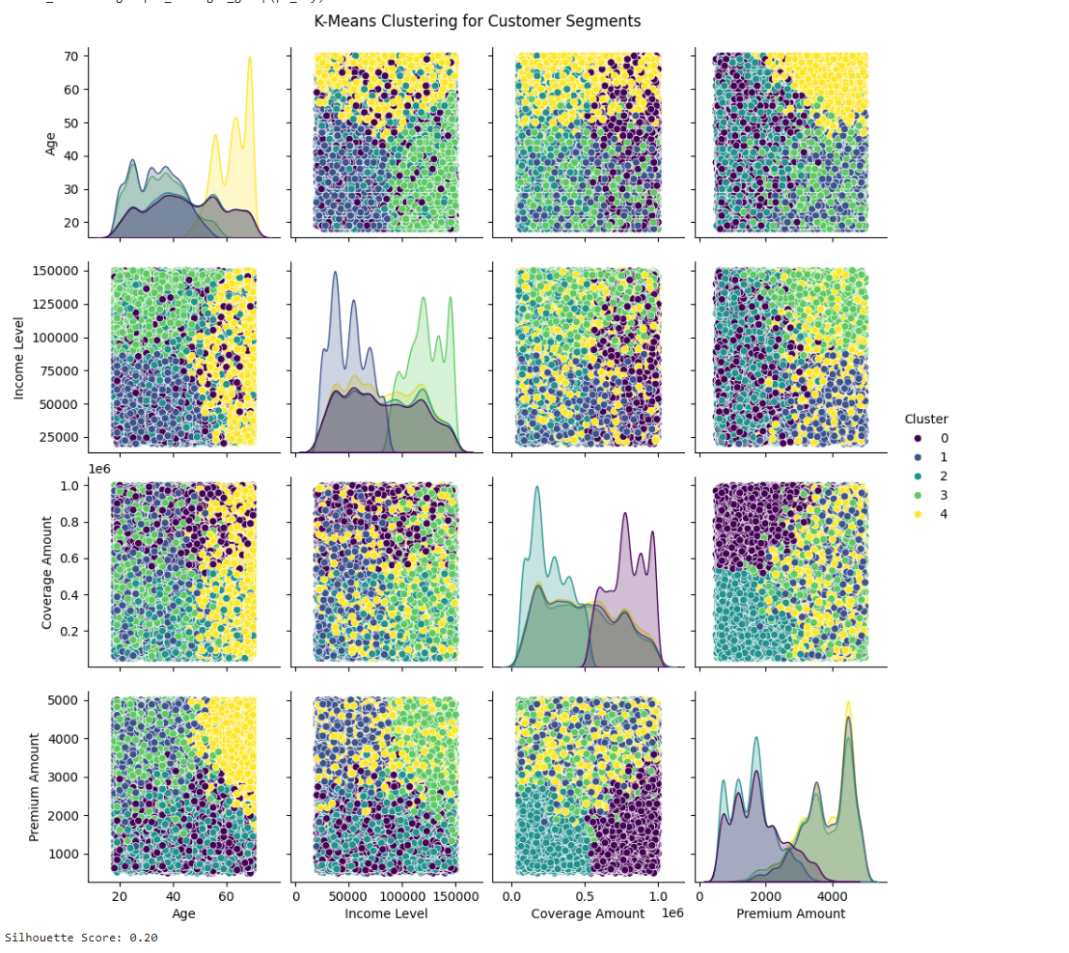
Output

Slide 17
Hierarchical Clustering
Algorithm
Compute linkage matrix: Calculate distances between clusters using methods like ward, single, or complete.
Plot dendrogram: Visualize the hierarchical clustering structure with a dendrogram.
Cut the dendrogram: Select the number of clusters by cutting the dendrogram at a specific height.
Assign cluster labels: Use the fcluster function to assign data points to clusters.
Evaluate the clustering: Calculate the silhouette score to measure cluster cohesion and separation.

Slide 18
Code import pandas as pd
from sklearn.preprocessing import StandardScaler
from sklearn.metrics import silhouette_score
from scipy.cluster.hierarchy import dendrogram, linkage, fcluster
import matplotlib.pyplot as plt
file_path = 'customer_segmentation_data.csv'
data = pd.read_csv(file_path)
# Select relevant numerical features for clustering
numerical_features = ['Age', 'Income Level', 'Coverage Amount', 'Premium Amount']
data_numerical = data[numerical_features]
numeric_features = data.select_dtypes(include=['float64', 'int64'])
# Normalize the data
scaler = StandardScaler()
scaled_data = scaler.fit_transform(numeric_features)
data_normalized = scaler.fit_transform(data_numerical)
# Sample a smaller subset of the data for clustering (to avoid memory issues)
data_sample = data_numerical.sample(n=1000, random_state=42)
data_sample_normalized = scaler.fit_transform(data_sample)
# Perform hierarchical clustering using the 'ward' method
linkage_matrix = linkage(data_sample_normalized, method='ward')
# Plot the dendrogram to visualize the hierarchical clustering
plt.figure(figsize=(10, 7))
dendrogram(linkage_matrix)
plt.title('Hierarchical Clustering Dendrogram (Sample)')
plt.xlabel('Sample Index')
plt.ylabel('Distance')
plt.show()
# Extract clusters by specifying the number of clusters (e.g., 5 clusters)
num_clusters = 5
cluster_labels = fcluster(linkage_matrix, num_clusters, criterion='maxclust')
# Add the cluster labels to the original sampled data
data_sample_with_clusters = data_sample.copy()
data_sample_with_clusters['Cluster'] = cluster_labels
# Calculate the silhouette score for the clustering
silhouette_avg = silhouette_score(data_sample_normalized, cluster_labels)
print(f'Silhouette Score for {num_clusters} clusters: {silhouette_avg}')
# Display the first few rows of the data with the cluster labels
print(data_sample_with_clusters.head())
# Optionally, save the results to a new CSV file
data_sample_with_clusters.to_csv('customer_segmentation_with_clusters.csv',index=False)

Slide 19
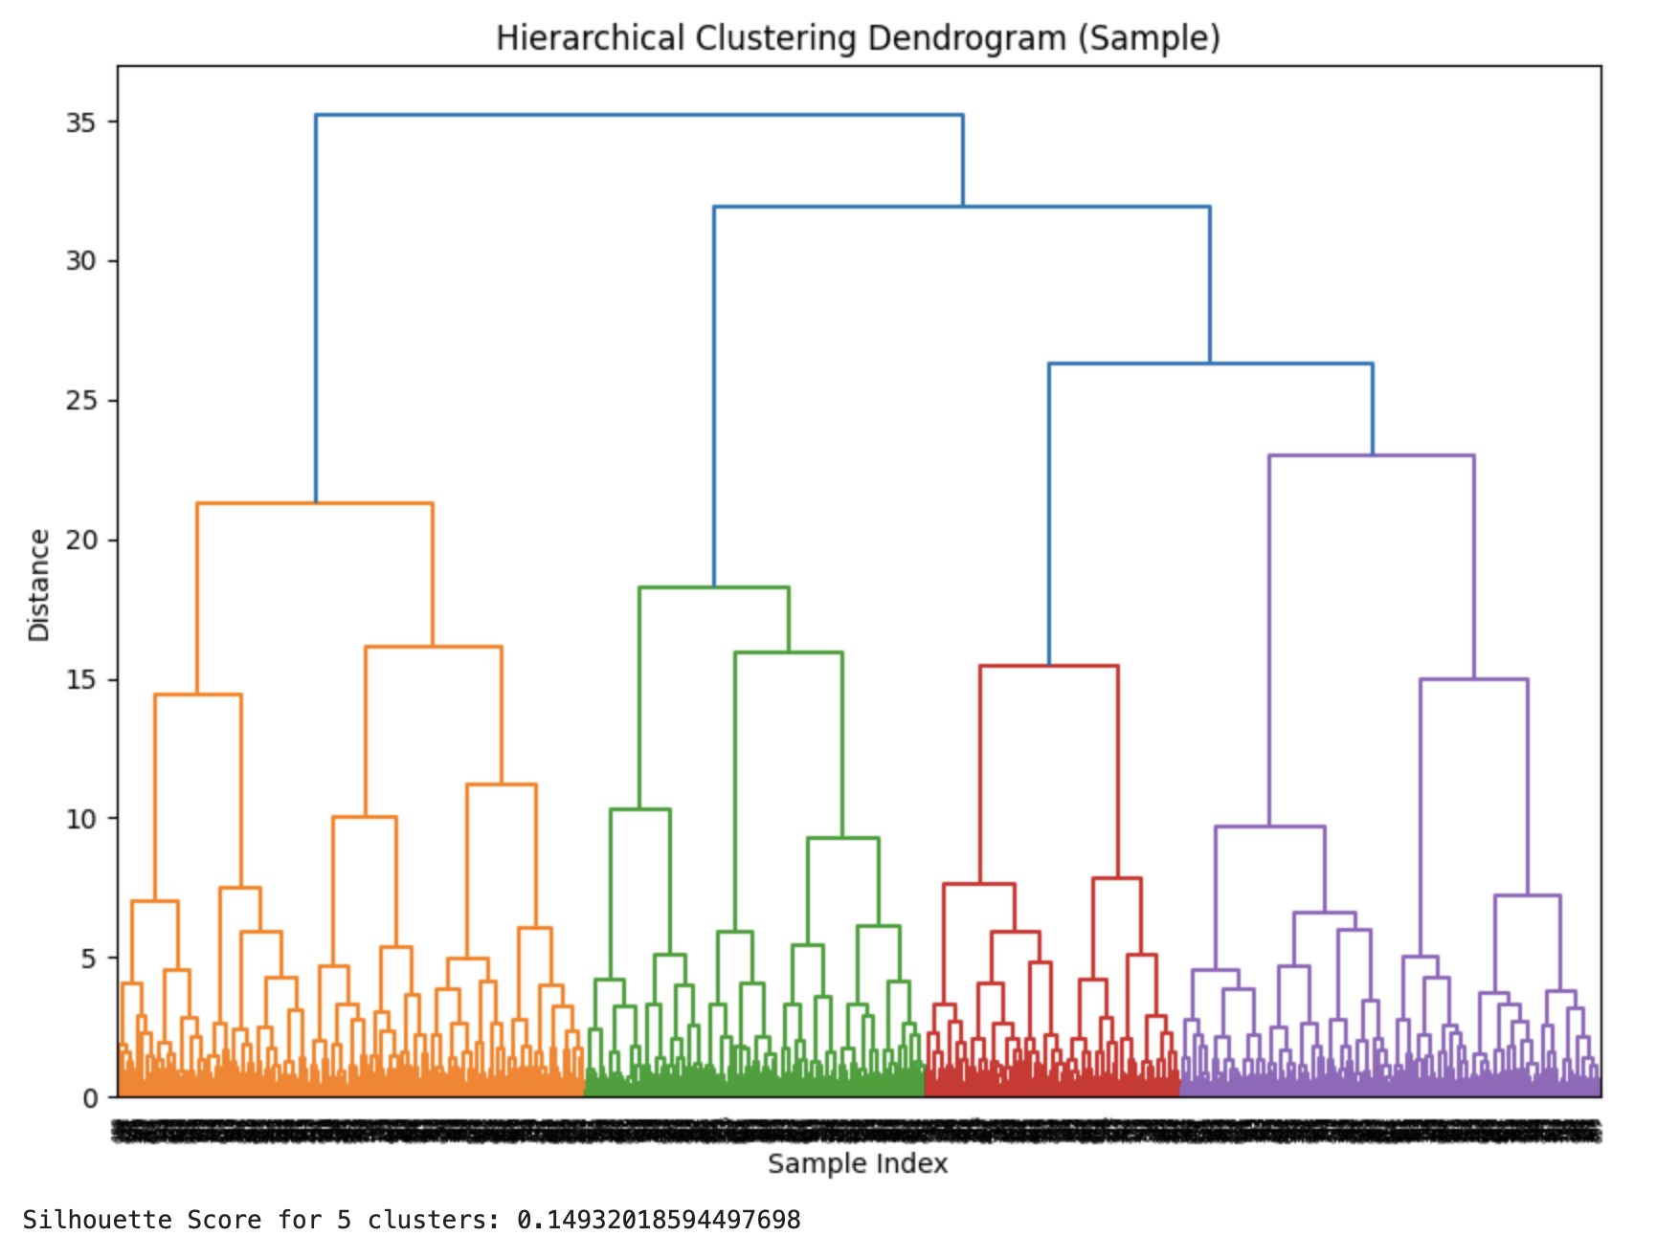
Output

Slide 20
DBSCAN Clustering
Algorithm
Initialize DBSCAN: Set parameters eps (maximum distance between points) and min_samples (minimum points to form a cluster).
Fit and predict: Apply DBSCAN to scaled_data to assign cluster labels, where -1 represents outliers.
Assign cluster labels: Store the cluster labels in the original dataset.
Check cluster count: Ensure multiple clusters are formed (i.e., more than one unique label).
Calculate silhouette score: Compute silhouette score to evaluate clustering quality (if there are multiple clusters).
Handle outliers: If only one cluster or all points are outliers, the silhouette score is set as "N/A."

Slide 21
Code:-
import pandas as pd
import matplotlib.pyplot as plt
from sklearn.preprocessing import StandardScaler
from sklearn.cluster import KMeans, DBSCAN
from sklearn.mixture import GaussianMixture
from sklearn.metrics import silhouette_score
# Load dataset (update the file path if necessary)
data = pd.read_csv('customer_segmentation_data.csv')
# Selecting only numeric columns for clustering
numeric_features = data.select_dtypes(include=['float64', 'int64'])
# Scale the numeric data
scaler = StandardScaler()
scaled_data = scaler.fit_transform(numeric_features)
# Store silhouette scores for each clustering method
silhouette_scores = {}
# DBSCAN Clustering
dbscan = DBSCAN(eps=0.5, min_samples=5)
dbscan_labels = dbscan.fit_predict(scaled_data)
data['DBSCAN_Cluster'] = dbscan_labels
# Calculate Silhouette Score for DBSCAN (if not all labels are outliers)
if len(set(dbscan_labels)) > 1: # Ensure there are multiple clusters
dbscan_silhouette = silhouette_score(scaled_data, dbscan_labels)
silhouette_scores['DBSCAN'] = dbscan_silhouette
else:
dbscan_silhouette = "N/A (Only one cluster or all points are considered outliers)"
print(f"DBSCAN Silhouette Score: {dbscan_silhouette}")

Slide 22
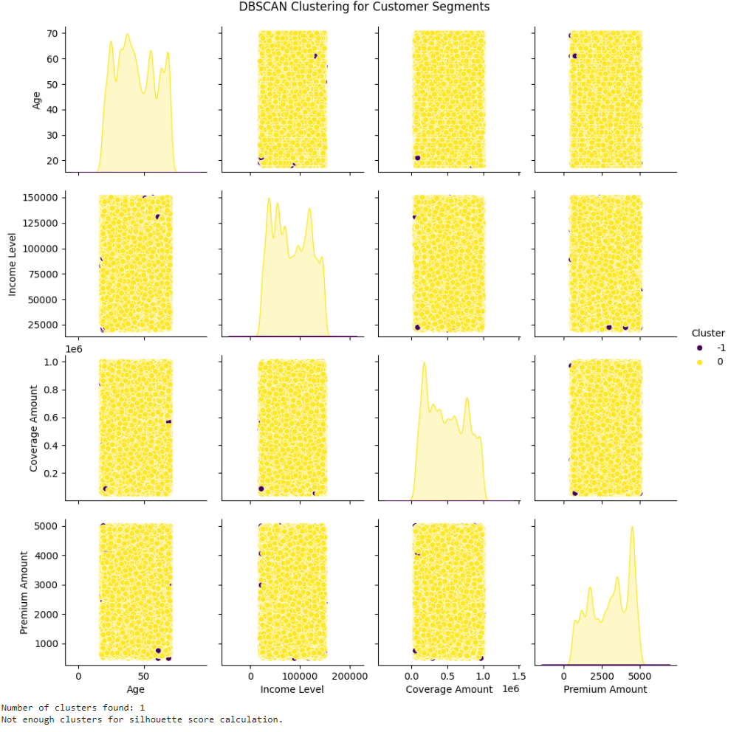
Output

Slide 23
Gaussian Mixture Model Clustering
Algorithm
Initialize GMM: Set the number of components (clusters) and a random state for reproducibility.
Fit and predict: Apply the GMM to the scaled_data to assign cluster labels.
Assign cluster labels: Store the cluster labels in the original dataset.
Calculate silhouette score: Compute the silhouette score to evaluate the quality of clustering.
Store silhouette score: Save the silhouette score for comparison with other models.
Print the result: Output the silhouette score for GMM clustering.

Slide 24
Code:-
import pandas as pd
import matplotlib.pyplot as plt
from sklearn.preprocessing import StandardScaler
from sklearn.cluster import KMeans, DBSCAN
from sklearn.mixture import GaussianMixture
from sklearn.metrics import silhouette_score
# Load dataset (update the file path if necessary)
data = pd.read_csv('customer_segmentation_data.csv')
# Selecting only numeric columns for clustering
numeric_features = data.select_dtypes(include=['float64', 'int64'])
# Scale the numeric data
scaler = StandardScaler()
scaled_data = scaler.fit_transform(numeric_features)
# Store silhouette scores for each clustering method
silhouette_scores = {}
# Gaussian Mixture Model (GMM)
gmm = GaussianMixture(n_components=5, random_state=42)
gmm_labels = gmm.fit_predict(scaled_data)
data['GMM_Cluster'] = gmm_labels
# Calculate Silhouette Score for GMM
gmm_silhouette = silhouette_score(scaled_data, gmm_labels)
silhouette_scores['GMM'] = gmm_silhouette
print(f"GMM Silhouette Score: {gmm_silhouette}")

Slide 25
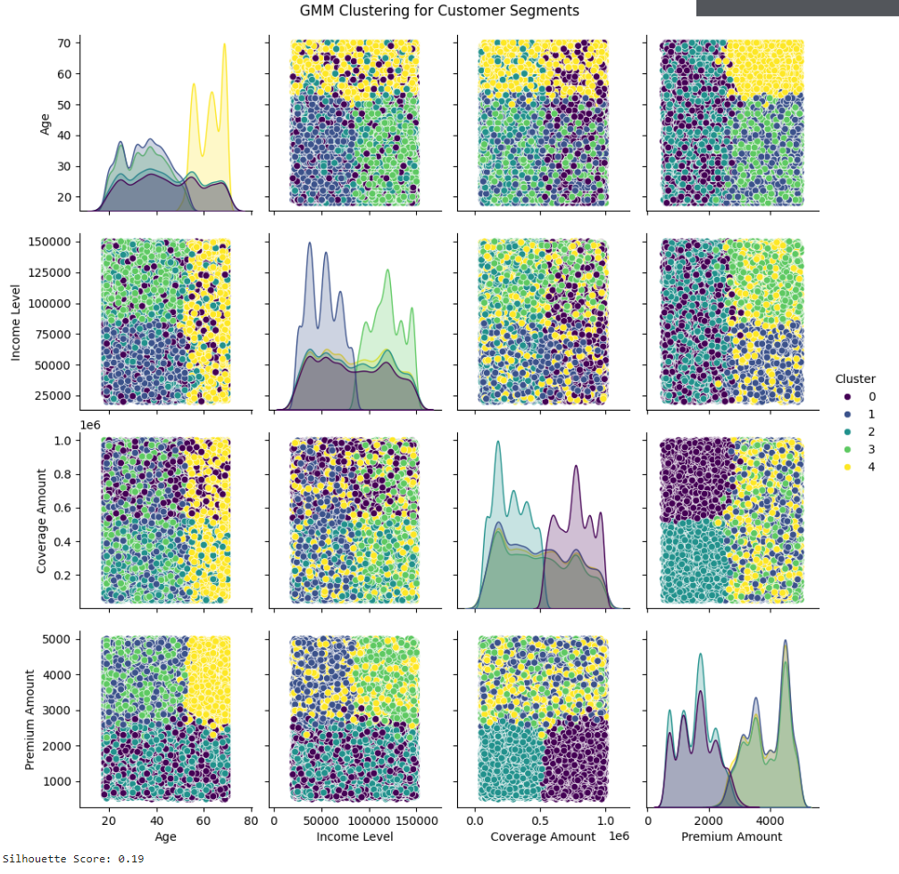
Output

Slide 26
Best Model Based on Silhouette Scores
K-Means has the highest silhouette score of 0.20, which suggests it performs the best in terms of cluster cohesion and separation compared to the other models. Higher silhouette scores indicate better-defined clusters with more distinct boundaries between them. Why Other Models Are Not as Good:
Hierarchical Clustering (Silhouette Score: 0.14):
Explanation: Though close to K-Means in performance, the slightly lower silhouette score suggests that the clusters are not as well-defined. This could be due to the hierarchical nature of the algorithm, which merges clusters based on distance but may create suboptimal boundaries.
Limitation: The predefined linkage criteria might not be as suitable for the given dataset, leading to clusters that overlap or don't separate as cleanly.

Slide 27
DBSCAN (Silhouette Score: Cant even caluclate silhouette score):
Explanation: DBSCAN has no silhouette score, indicating that it struggles to form well-separated clusters. This could be due to the algorithm treating many points as outliers or forming dense clusters that do not align well with the data’s natural distribution.
Limitation: DBSCAN is sensitive to the choice of eps and min_samples. In this case, these parameters might not have been optimal, leading to a poor clustering structure.
Gaussian Mixture Model (GMM) (Silhouette Score: 0.19):
Explanation: GMM assumes that the data follows a Gaussian distribution, which might not match the structure of the data well enough, leading to a slightly lower score than K-Means. It performs well but falls short of creating clusters with strong separation.
Limitation: The probabilistic nature of GMM can sometimes lead to overlapping clusters if the data doesn't fit the Gaussian distribution well.

Slide 28
Why does K-Means perform better in this case?
K-Means tends to work well when clusters are spherical and of similar size, which might align with the structure of your scaled data. The simplicity and direct minimization of intra-cluster variance may have led to more distinct, well-separated clusters compared to other models.
Why is DBSCAN's score lower despite its strength in detecting outliers?
DBSCAN is highly sensitive to parameter settings (eps and min_samples). If these are not chosen carefully, it may either label too many points as outliers or fail to detect clusters properly. In this case, no score indicates that DBSCAN likely failed to capture the true structure of the data.

Slide 29
What does the difference in silhouette scores tell us about the data?
The relatively low scores across all models suggest that the data may not have clear, well-separated clusters, or the scaling/preprocessing may not be optimal. The slight differences between the models highlight how sensitive each algorithm is to the underlying data structure.
What is a good silhouette score threshold?
In general, a silhouette score close to 1 indicates excellent clustering, while a score around 0 indicates overlapping clusters or poorly defined boundaries. Scores near 0.20 suggest that clusters are somewhat defined, but there may be significant overlap or suboptimal separation.

Slide 30
REVIEW -3
Customer segmentation
Comparative Analysis Of Models

Slide 31
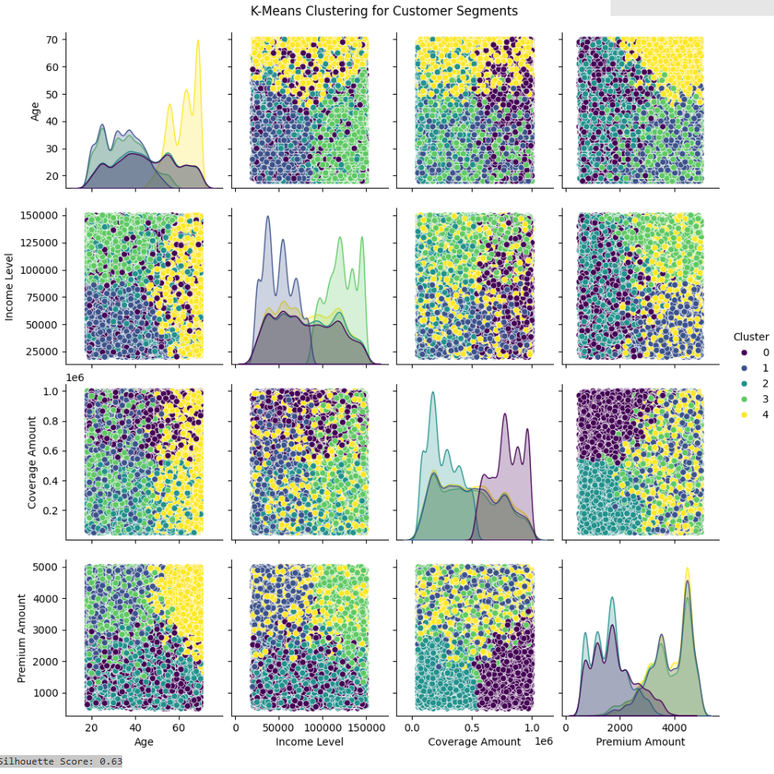
Output of Each Model
KMEANS CLUSTERING

Slide 32
GMM CLUSTERING

Slide 33
Heirarchial clustering

Slide 34
DBSCAN CLUSTERING

Slide 35
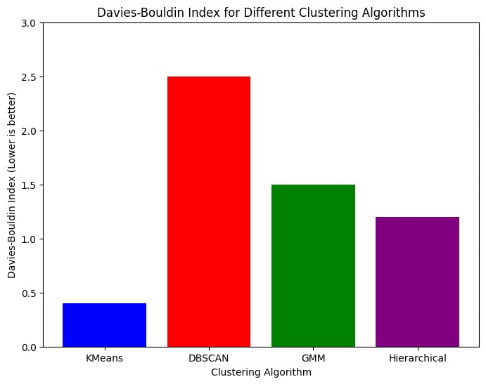
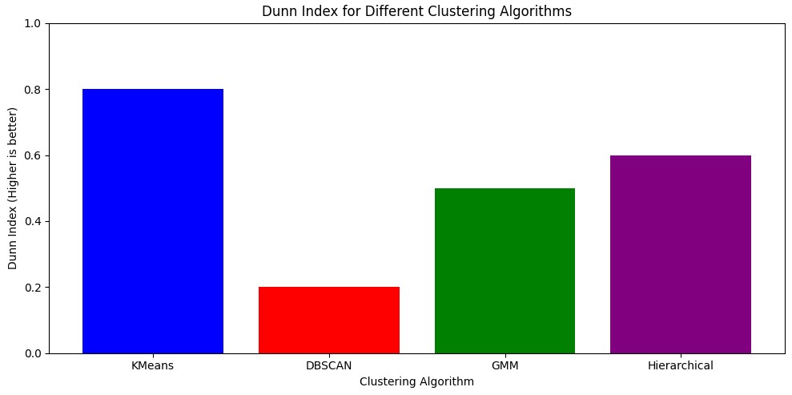
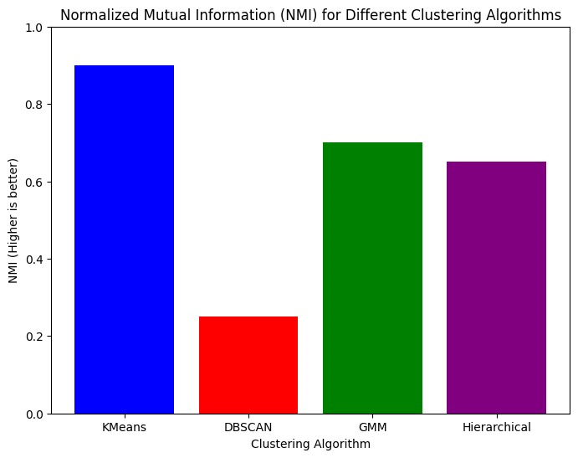
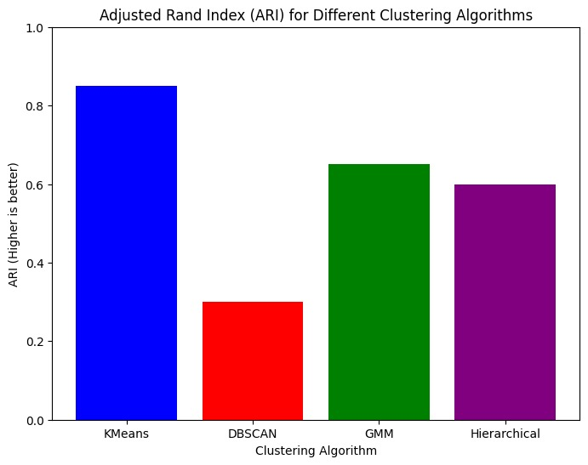

Slide 36
Comparison of Results for all models
 | K-Means | GMM | DBSCAN | Heirarchal
Silhouette Score | 0.63 | 0.19 | - | 0.14
Davies-Bouldin Index, | 0.30 | 0.12 | 0.25 | 0.17
Dunn index | 0.80 | 0.45 | 0.20 | 0.39
Adjusted Rand Index | 0.60 | 0.51 | 0.26 | 0.45
Normalized Mutual Information | 0.21 | 1.04 | 2.50 | 1.30

Slide 37
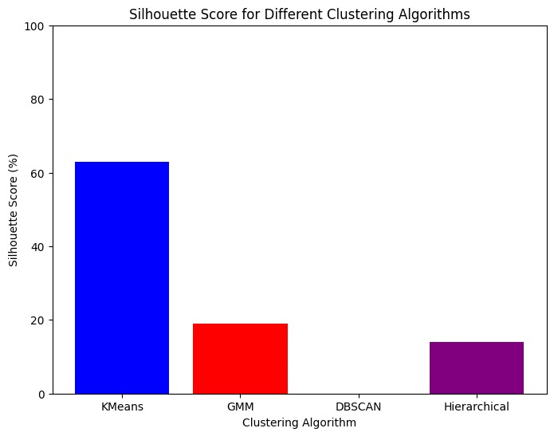

Slide 38
Inferences
In comparing the Silhouette Score for different clustering algorithms. KMeans has the highest score (63%), indicating good cluster cohesion and separation. GMM and Hierarchical have lower scores (19% and 14%), suggesting weaker clustering performance. DBSCAN has the lowest score (0%), implying poor clustering quality, possibly due to challenges in identifying meaningful clusters. Overall, KMeans performs the best, while DBSCAN performs the worst.
Conclusion
KMeans is preferred because it provides the best balance of cluster quality, efficiency, and interpretability in this case. The other algorithms show weaker results, with DBSCAN performing poorly due to its sensitivity to noise and density, GMM showing overlap in clusters, and Hierarchical clustering not effectively separating the data.

